Slide 1

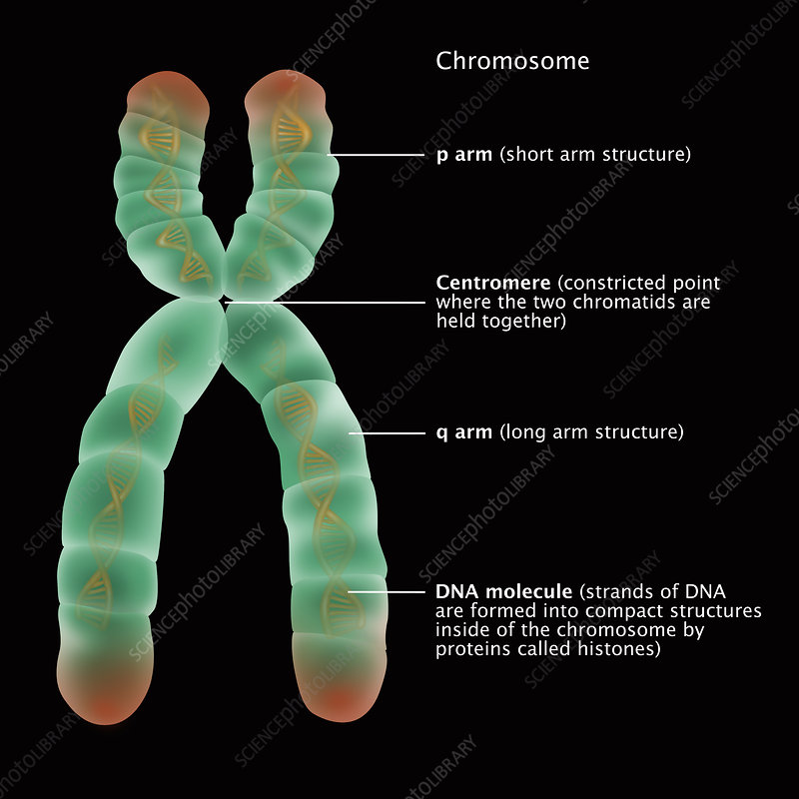

Kmeres – Identification of Centromeres and Telomeres
Using Kmer Profiles
Zemin Ning
https://github.com/wtsi-hpag/Kmeres
Notes:
1

Slide 2
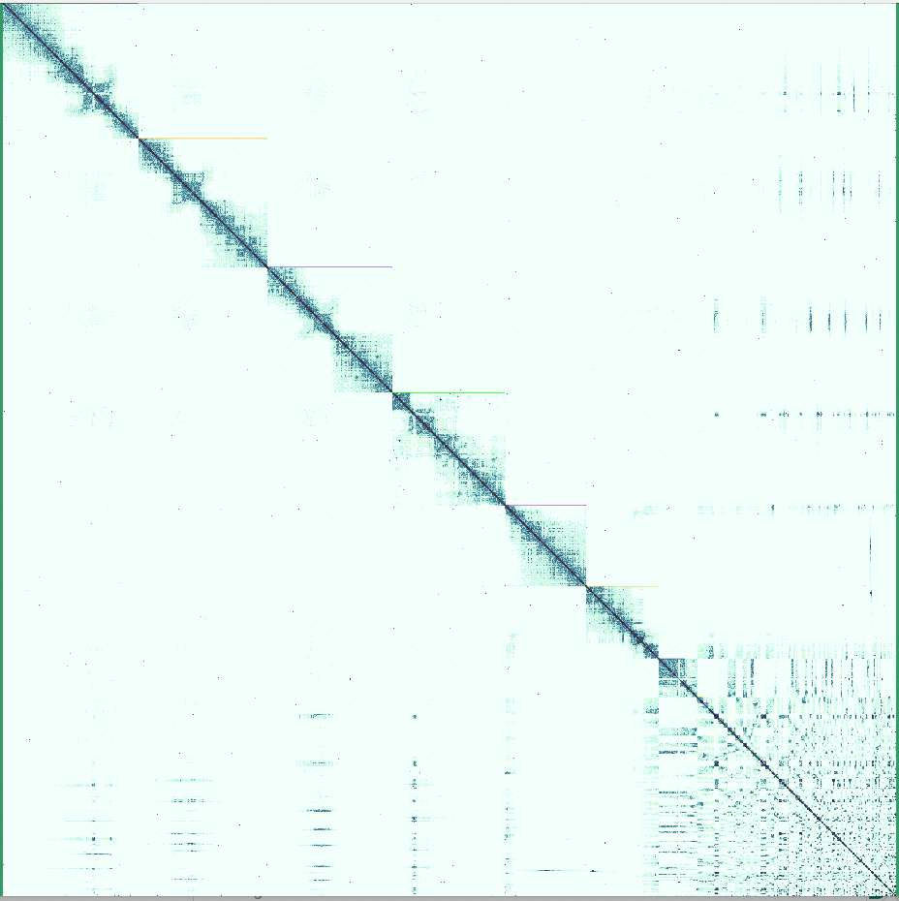
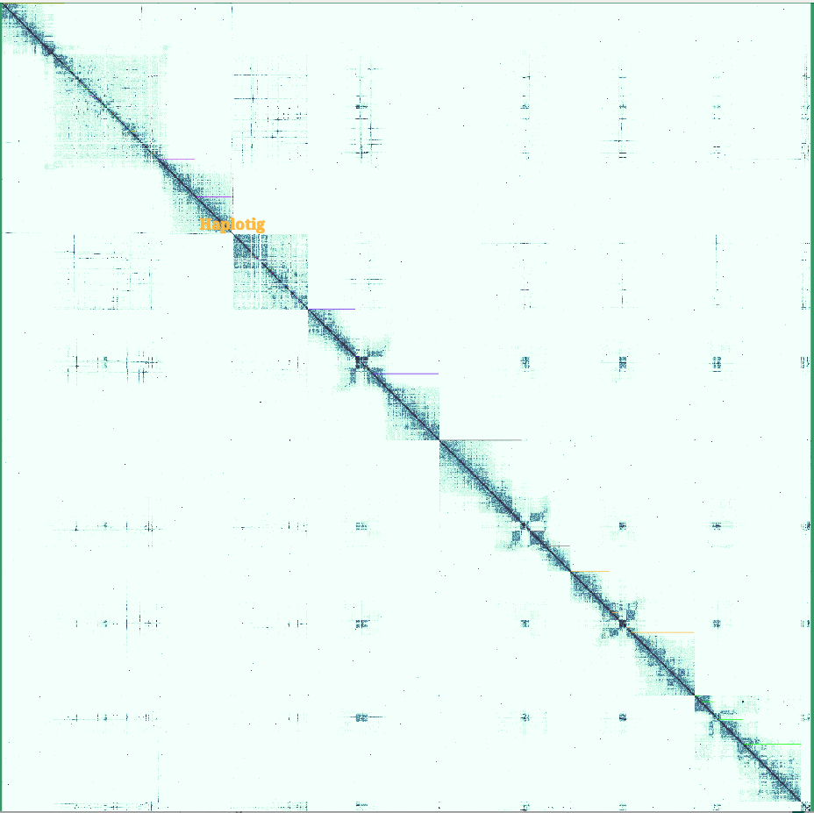
Challenges to Identify Genome Repeats
Genome assembly curation (idPhiCaes1_1)
Before Curation
After Curation
Centromere

Slide 3
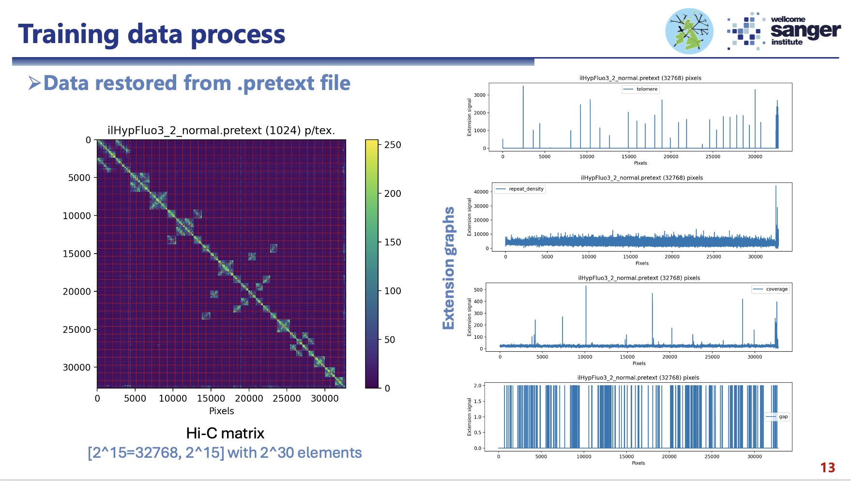

Slide 4
Unique and Repetitive DNA Sections
A X’ B X’’ C
Unique Section
Repetitive Section

Slide 5
Kmer Word Hashing
ATGGCGTGCAGTCCATGTTCGGATCA
ATGGCGTGCAGT
TGGCGTGCAGTC
GGCGTGCAGTCC
GCGTGCAGTCCA
CGTGCAGTCCAT
Contiguous
Base Hash
K = 12
Kmer Word
Chromosome ID
Location
ATGGCGTGCAGTCCATGTTCGGATCA
ATGGGCAGATGT
TGGCCAGTTGTT
GGCGAGTCGTTC
GCGTGTCCTTCG
Gap-Hash
4x3

Slide 6
Sorting the Kmer Words, Chr Index and Locations
ACAGAAAAGC
Chr i
Chr i
Chr i
Chr i
Chr i
Chr i
Chr i
Chr i
Chr i
Chr i
Chr i
Chr i
Chr i
Loci j
Loci j
Loci j
Loci j
Loci j
Loci j
Loci j
Loci j
Loci j
Loci j
Loci j
Loci j
Loci j
ACAGAAAAGC
ACAGAAAAGC
ACAGAAAAGC
ACAGAAAAGC
ACAGAAAAGC
ACAGAAAAGC
ACAGAAAAGC
ACAGAAAAGG
ACAGAAAAGG
ACAGAAAAGG
ACAGAAAAGG
ACAGAAAAGG
ACAGAAAAGG

Slide 7
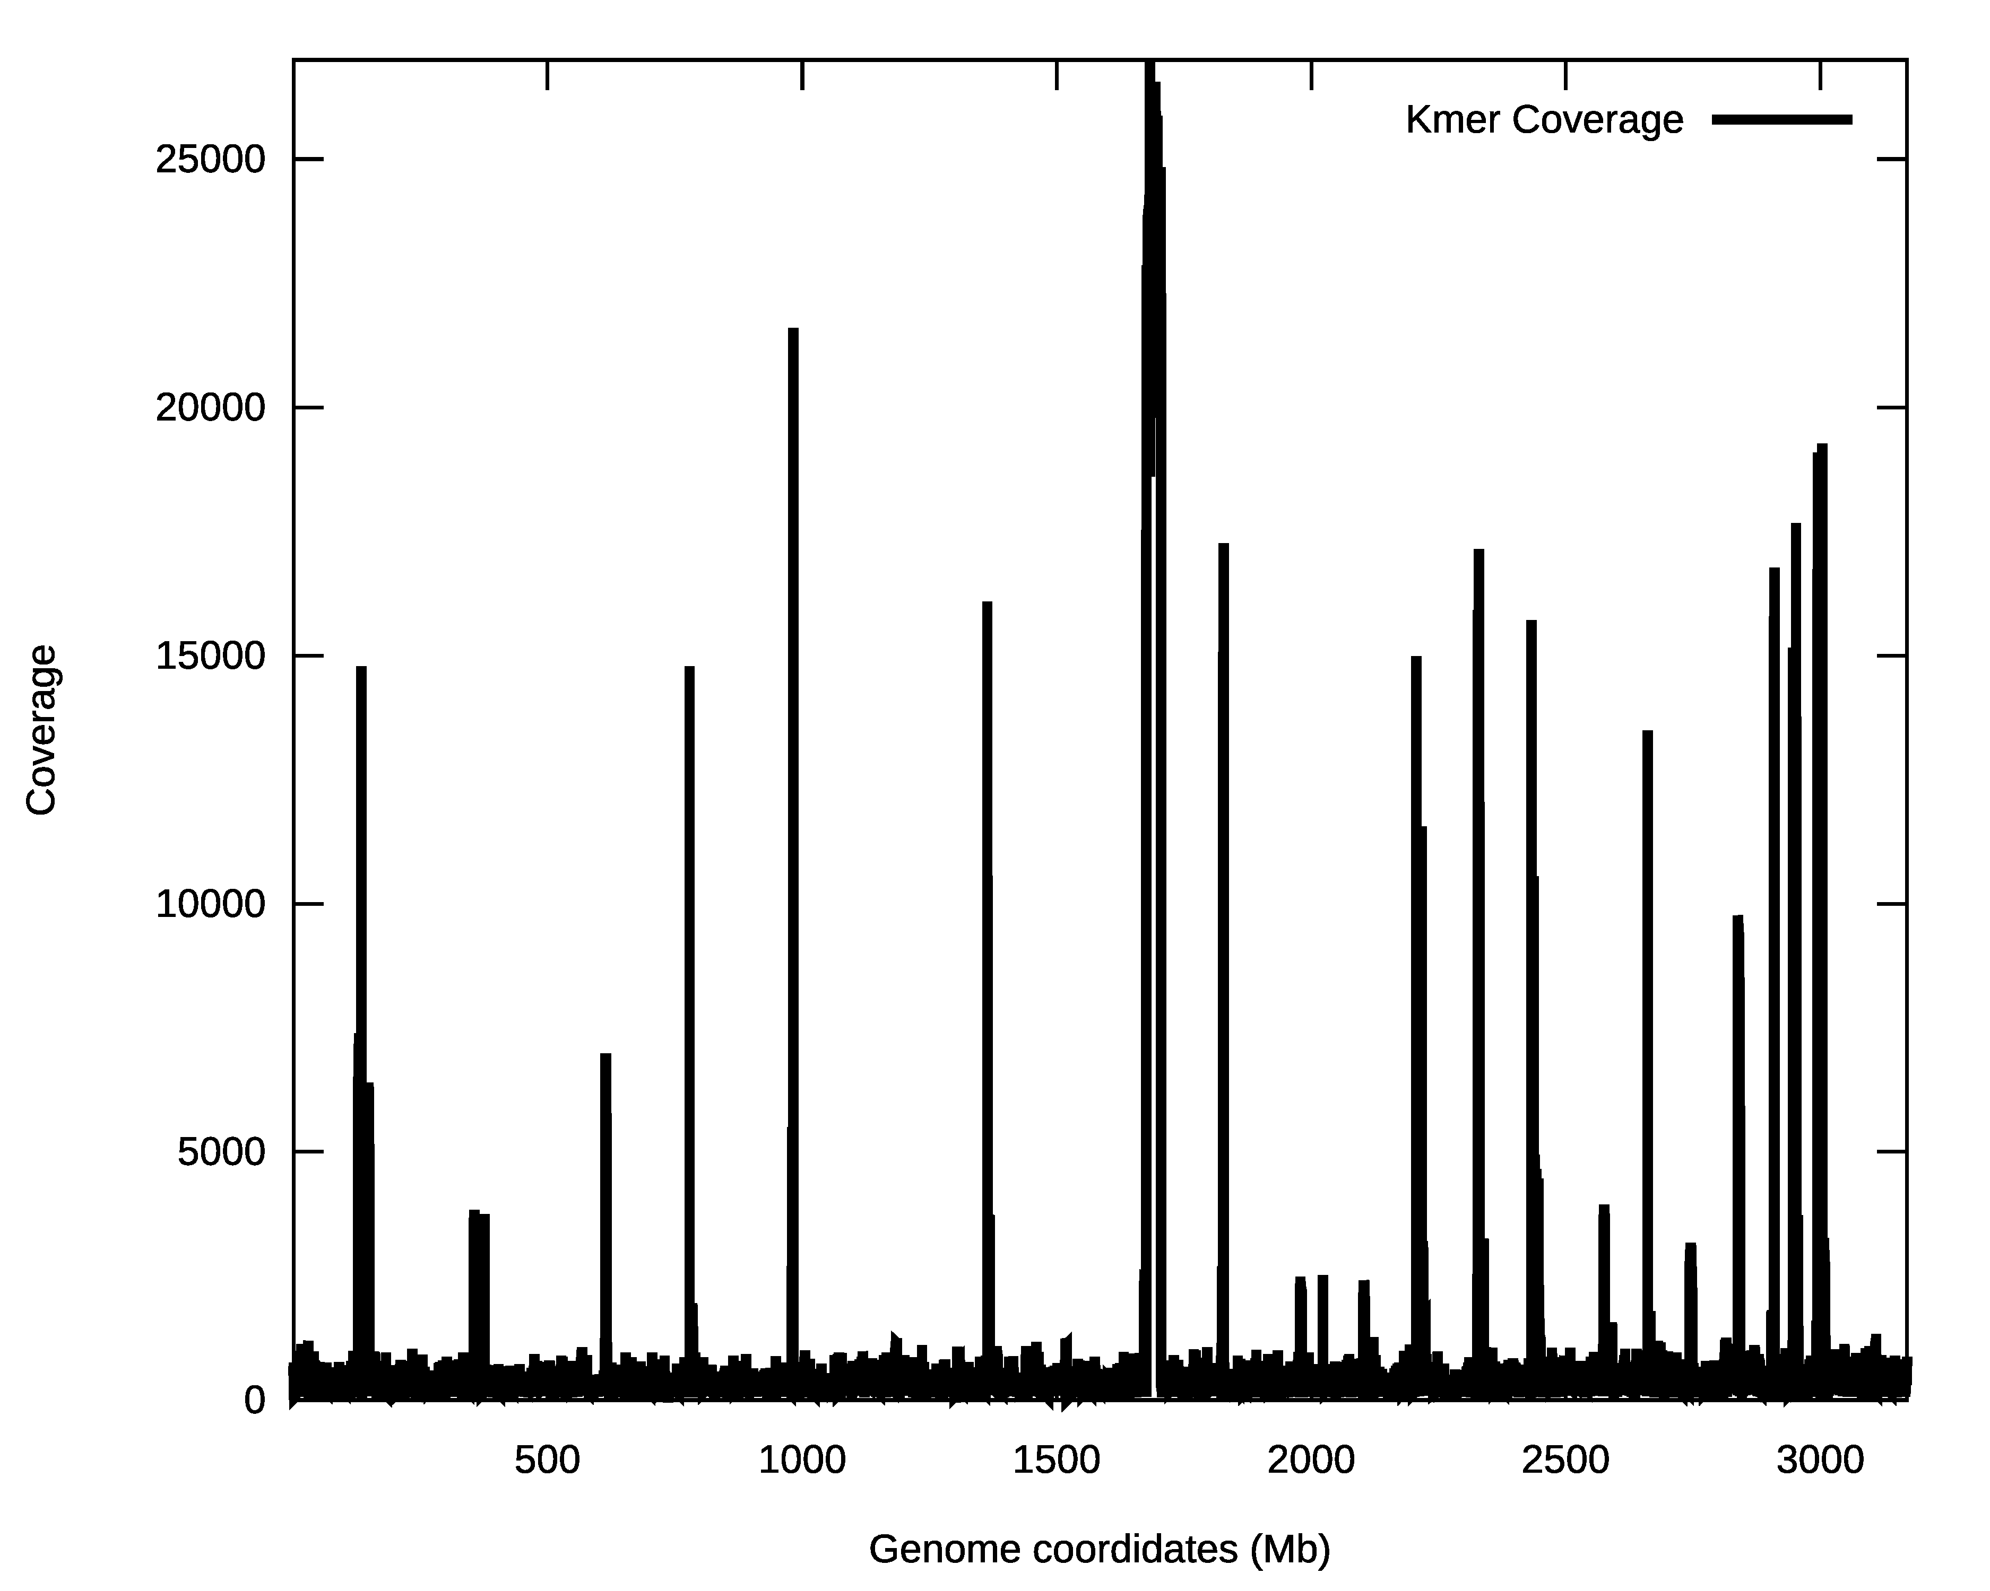
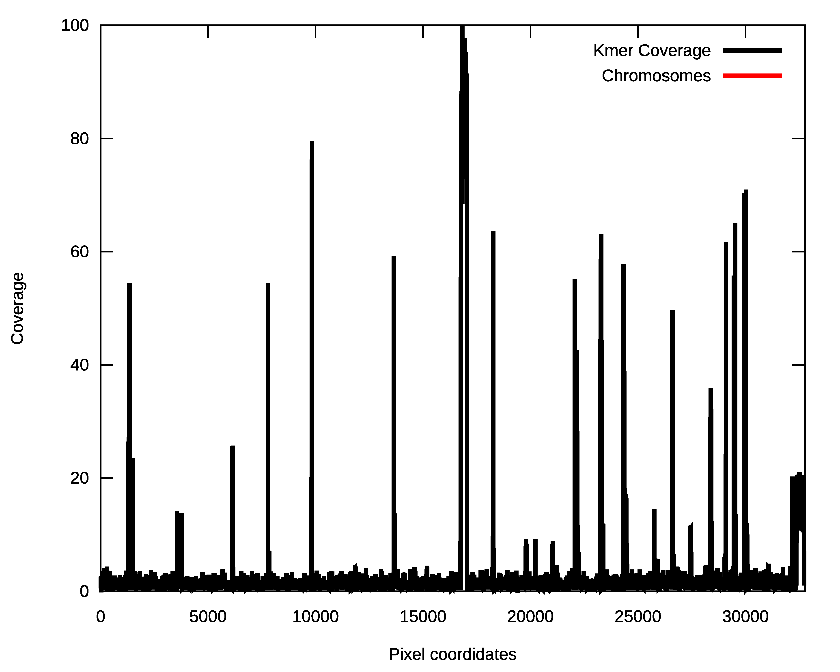
Converting Genome Repeats to
Dimensionless Pixel Coverage

Slide 8
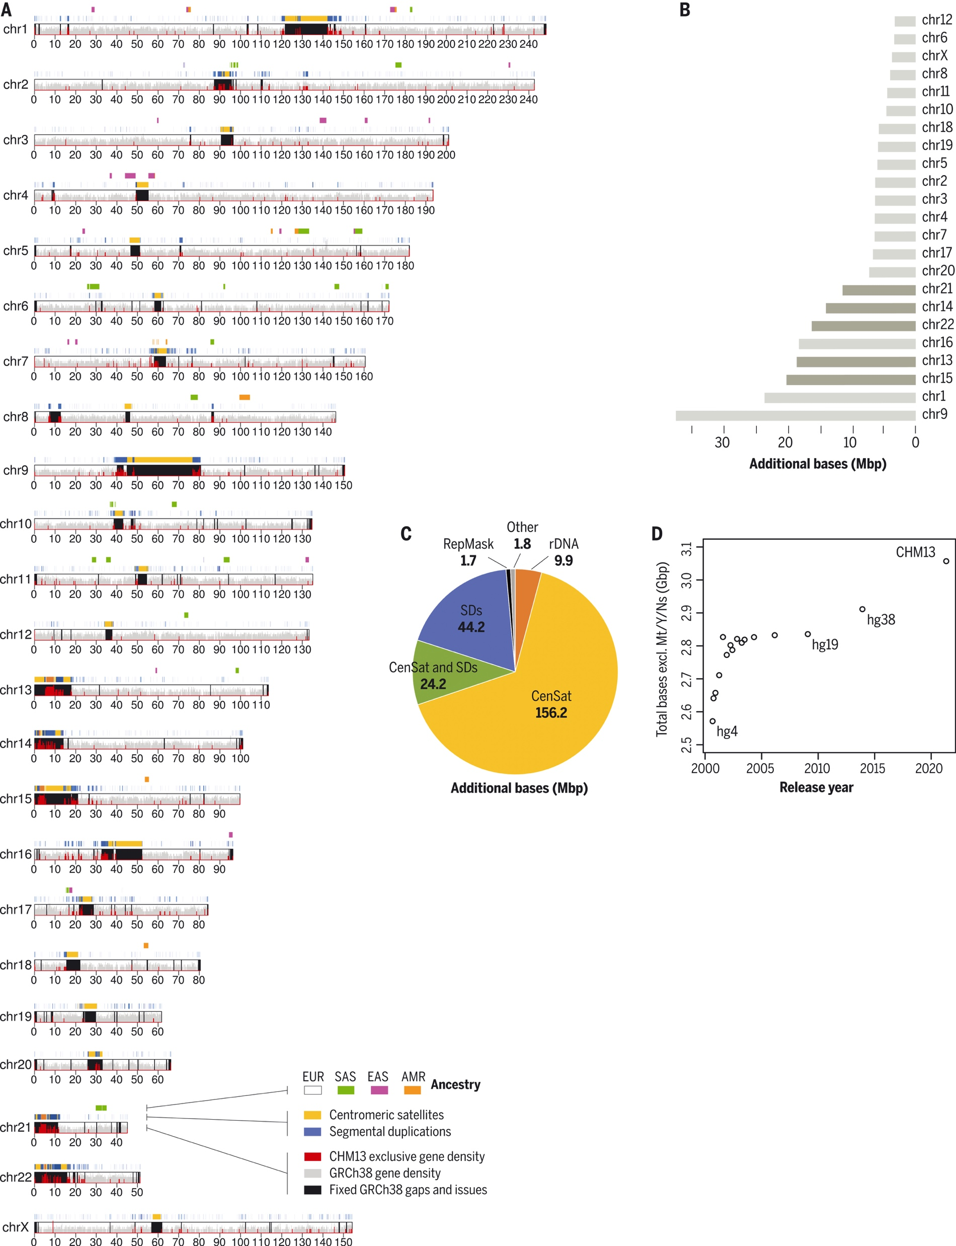
Centromere Locations – Human CHM13

Slide 9
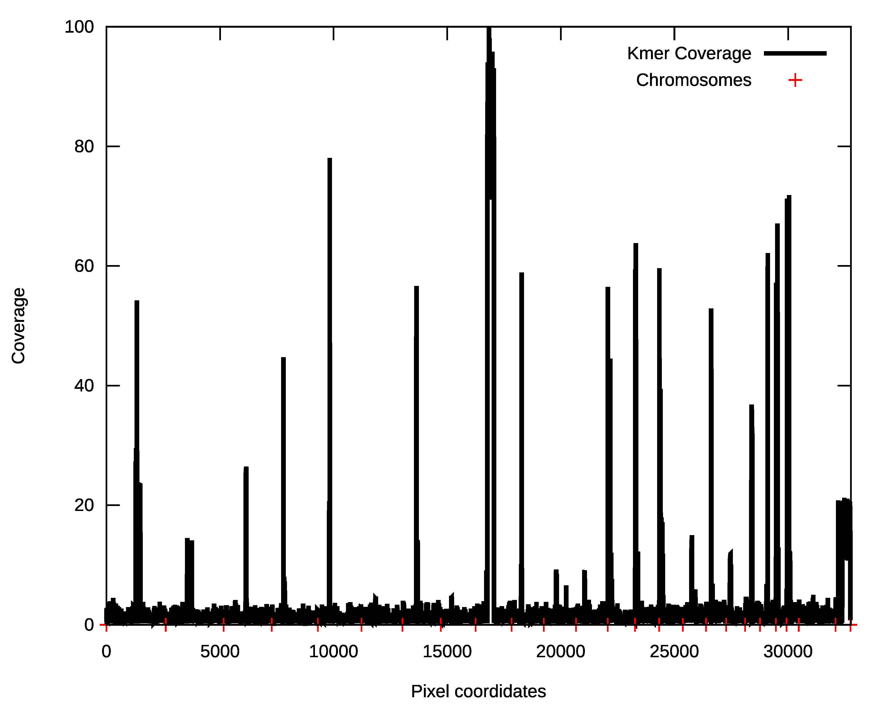
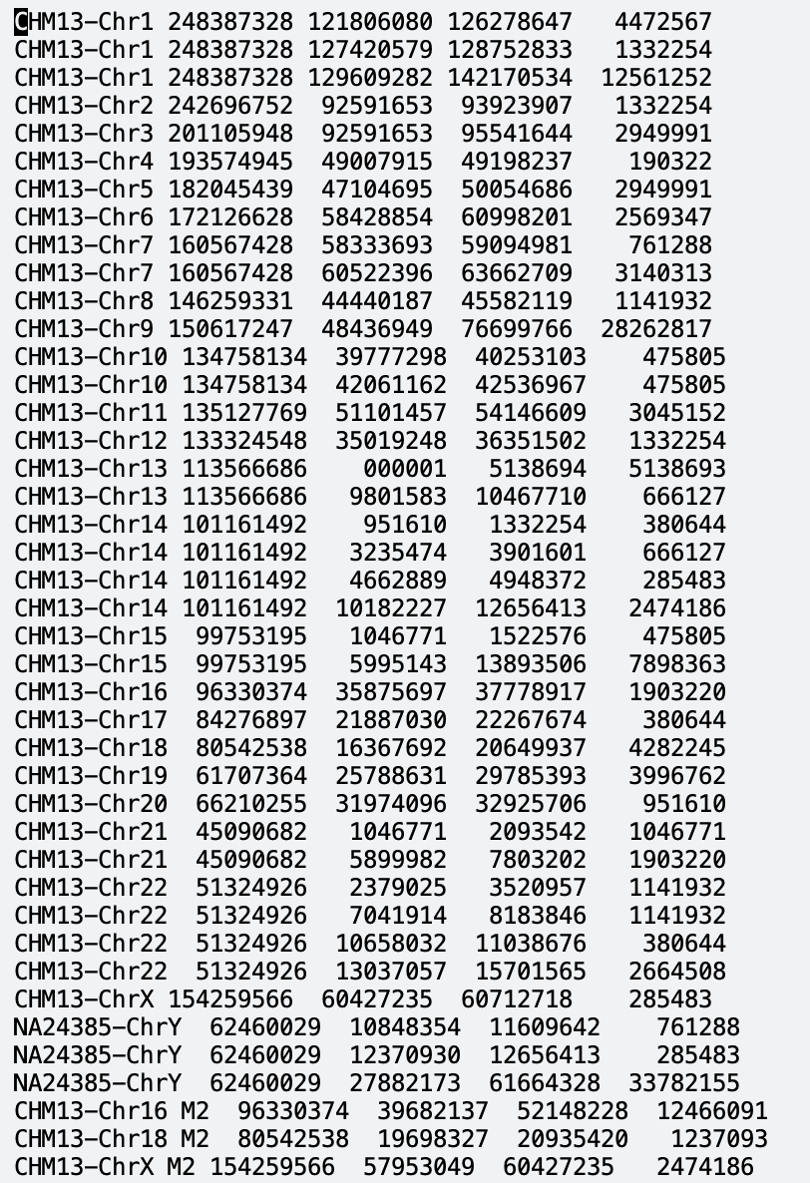
Human Repeat Density on Pixels

Slide 10
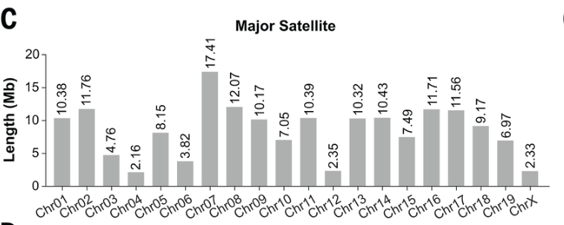
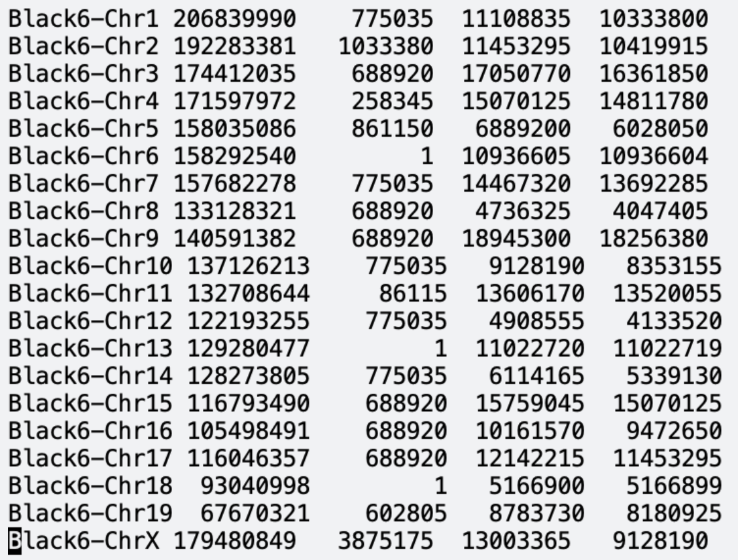
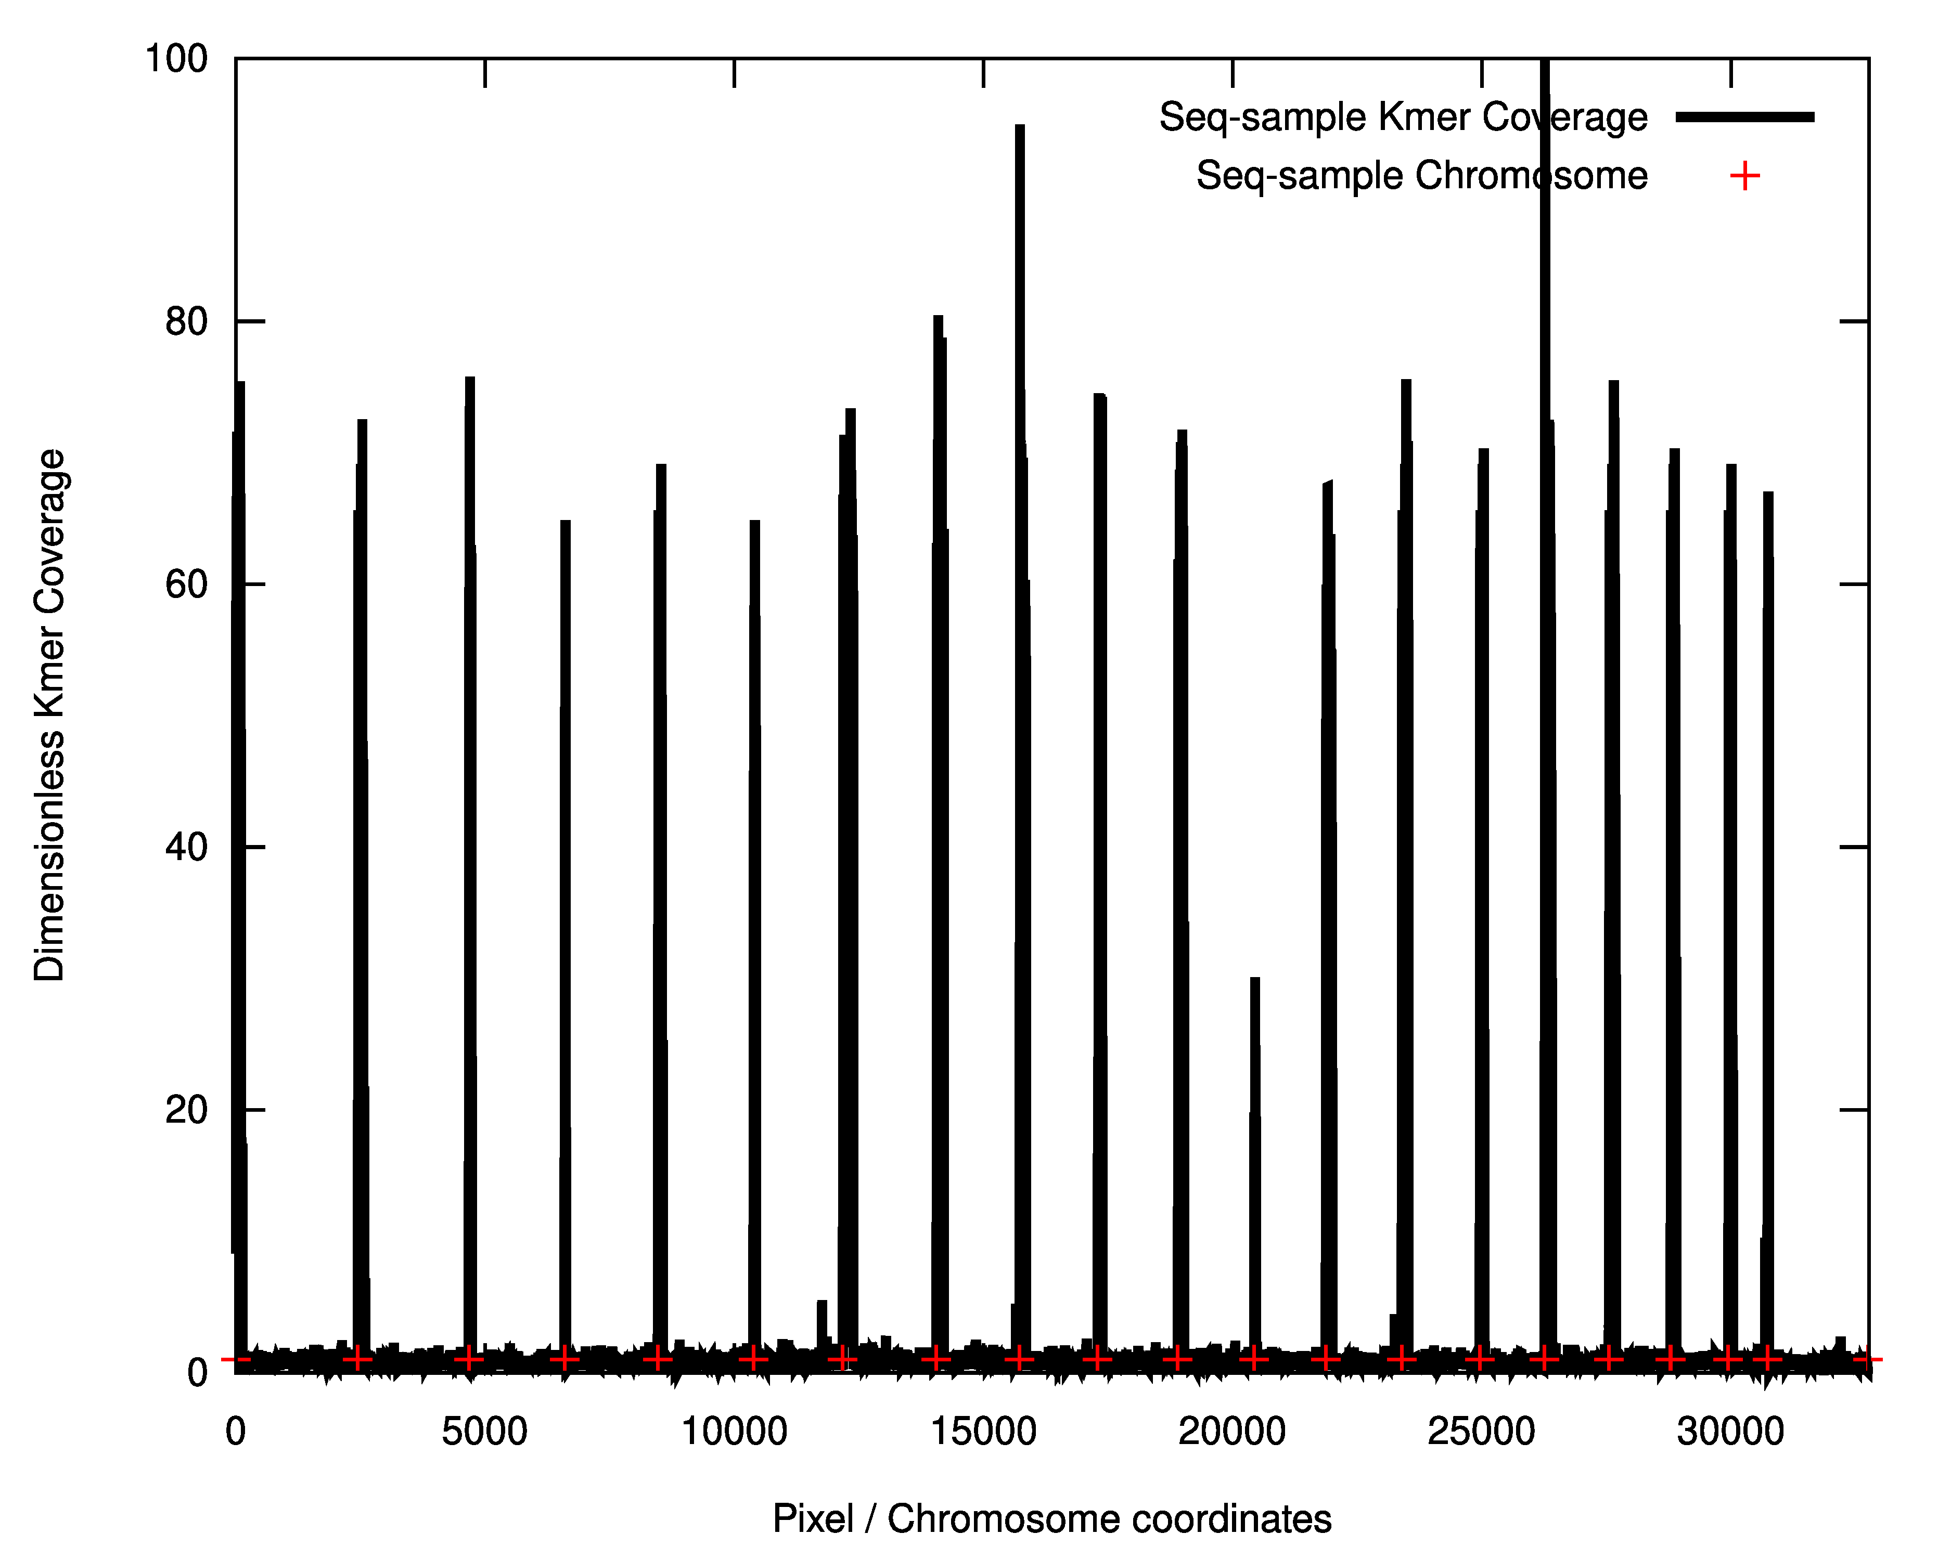
Centromere Locations – Mouse Black6

Slide 11
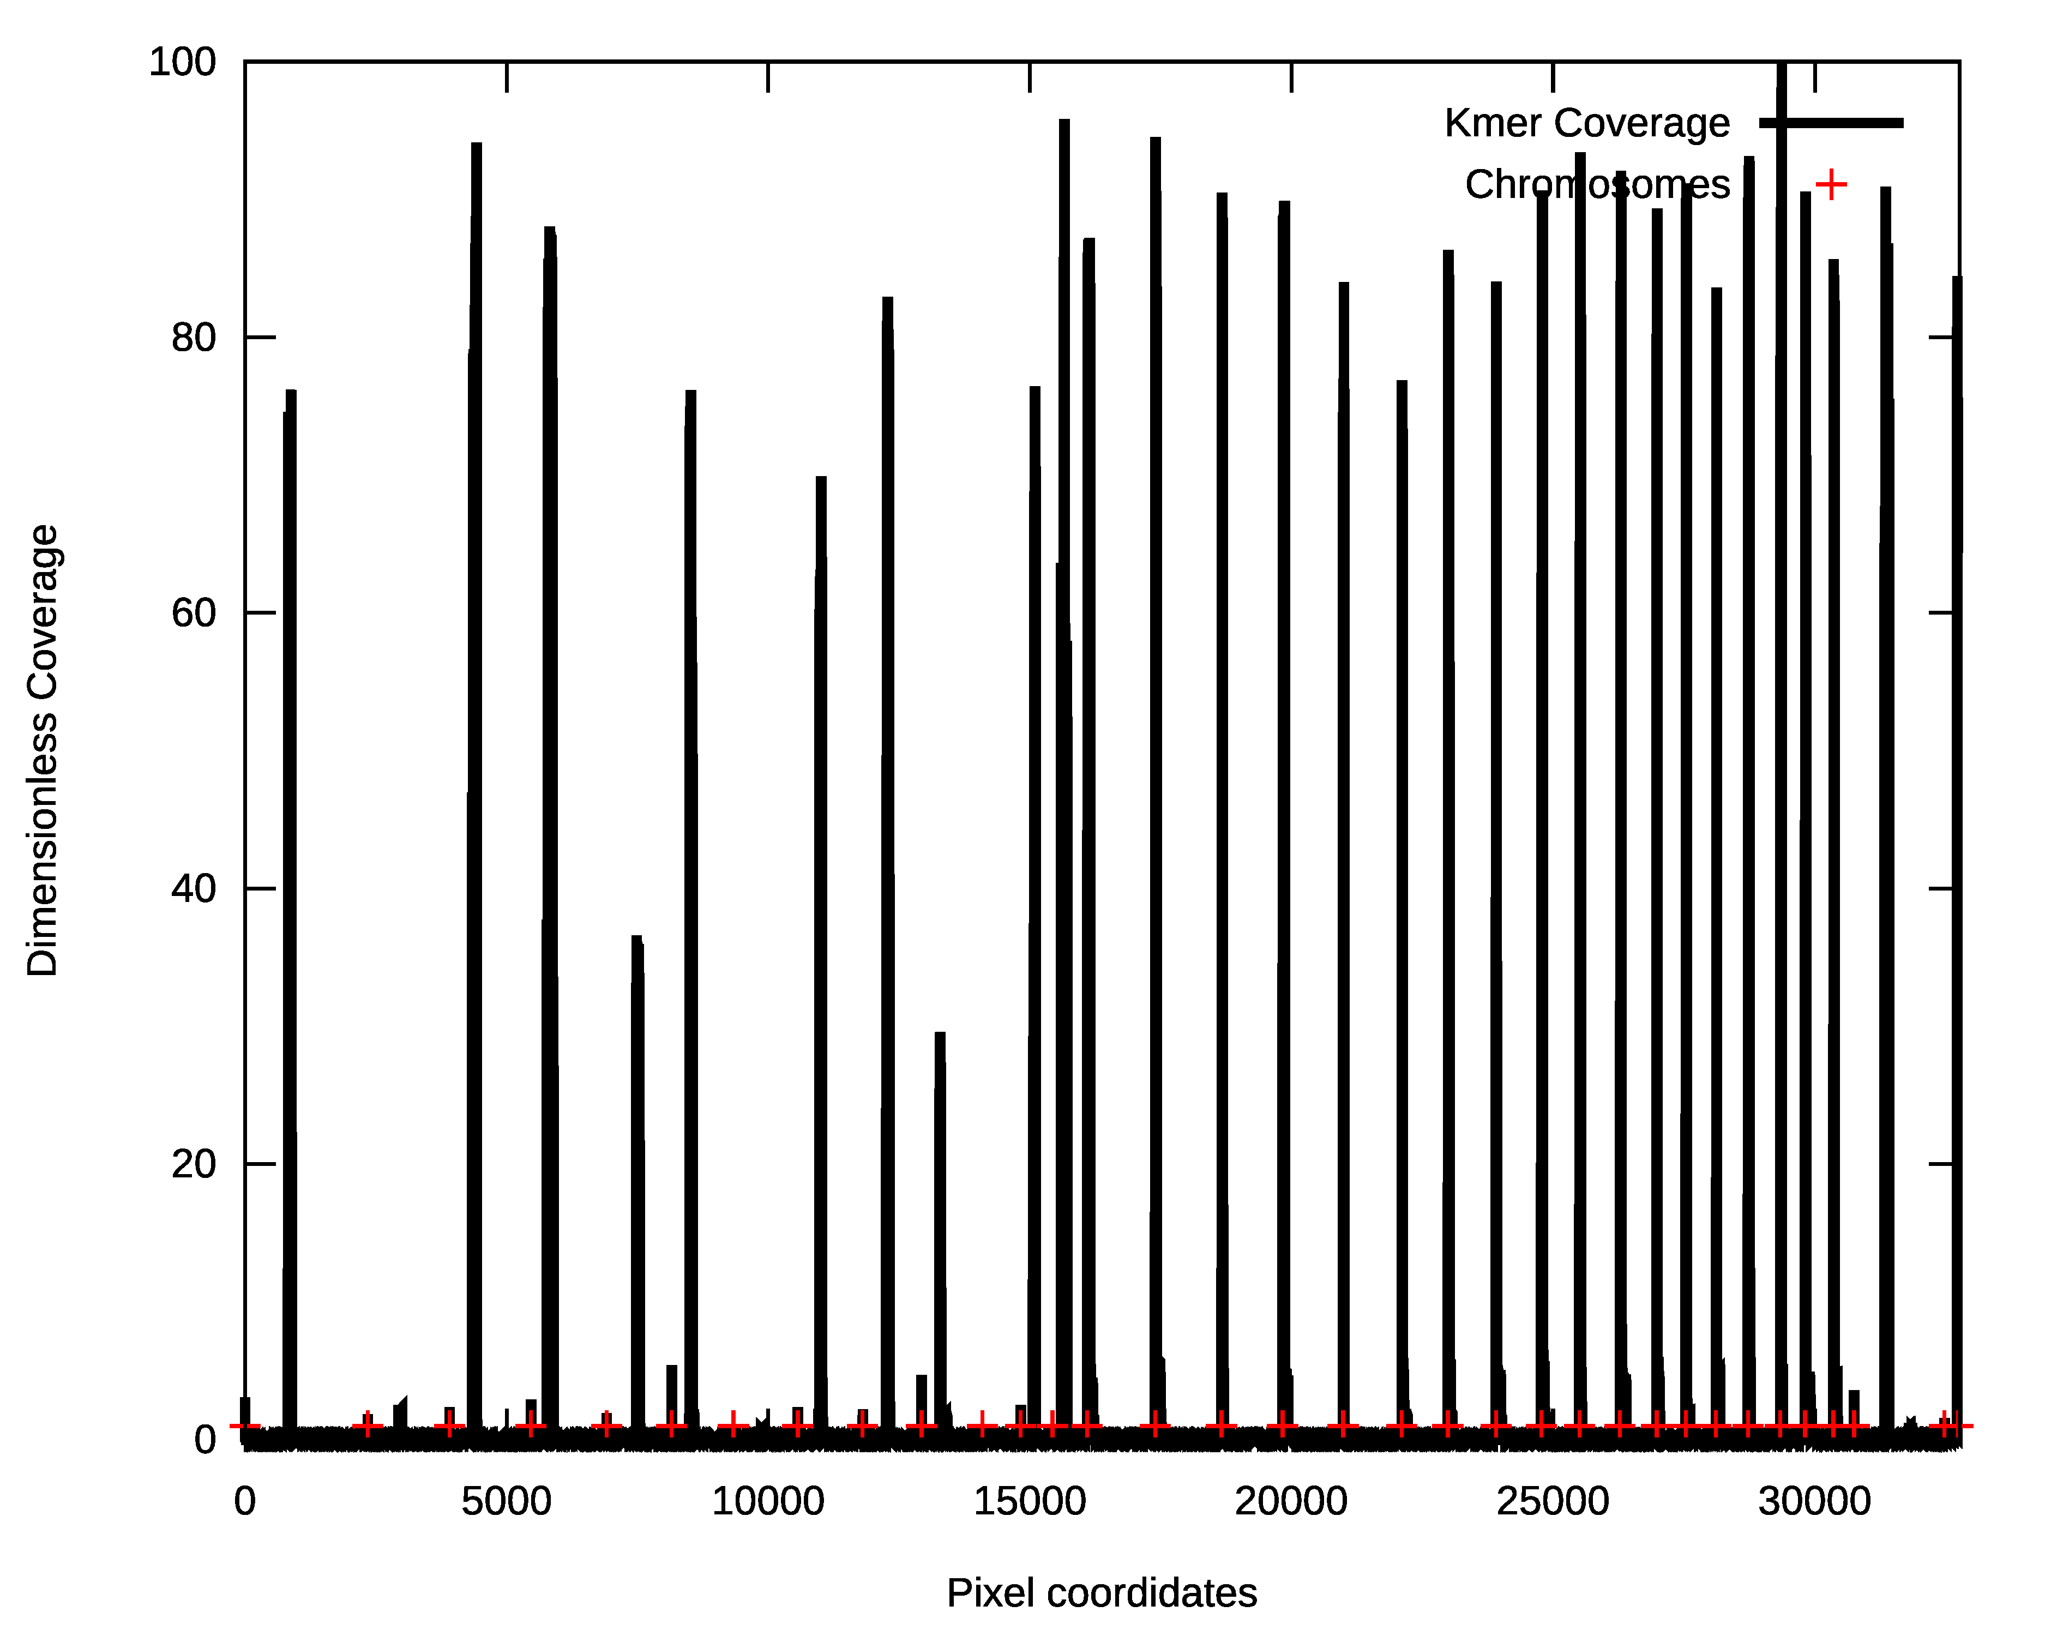
Centromere Locations – Horse Genome

Slide 12
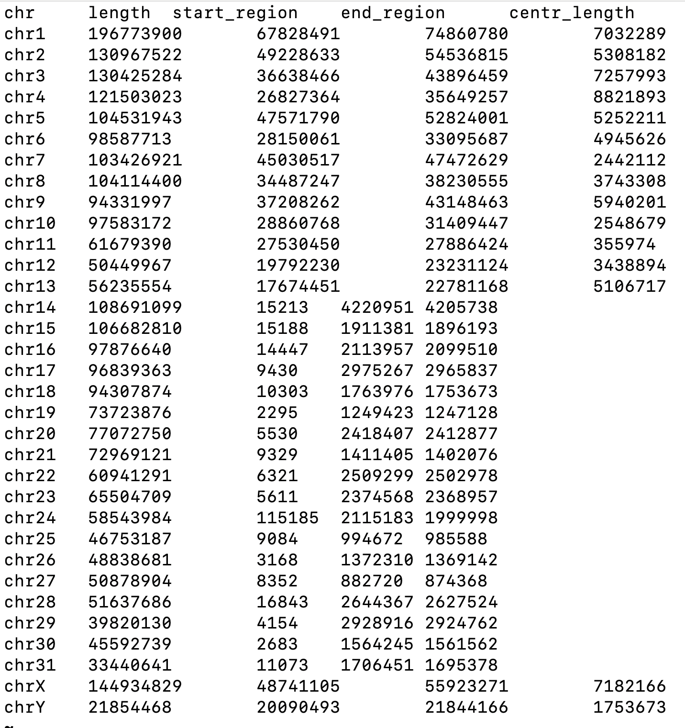
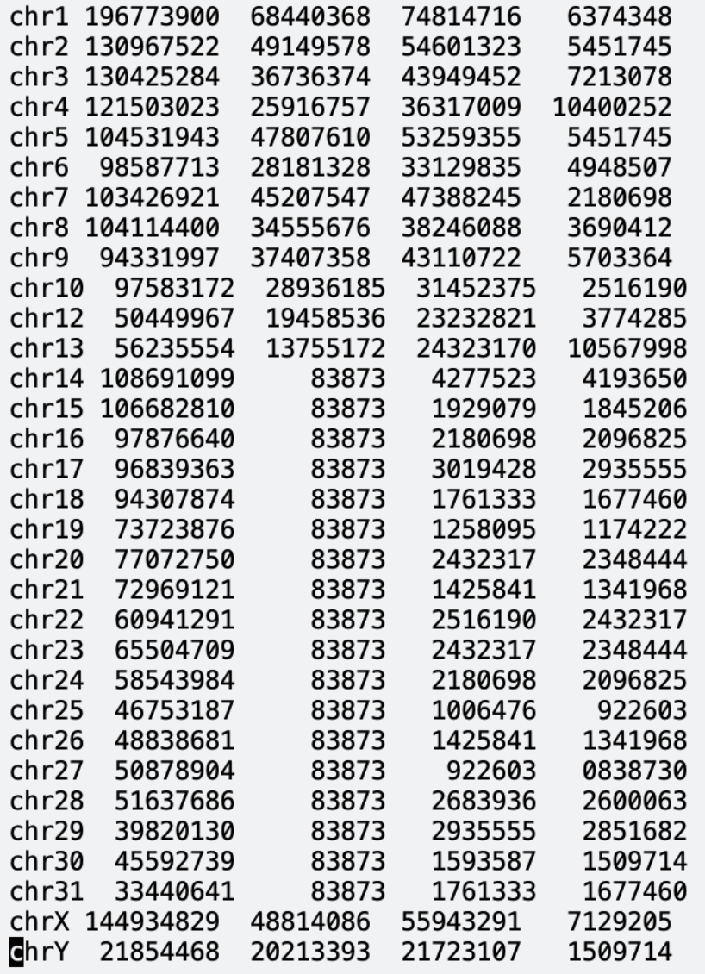
Horse Genome Centromeres

Slide 13
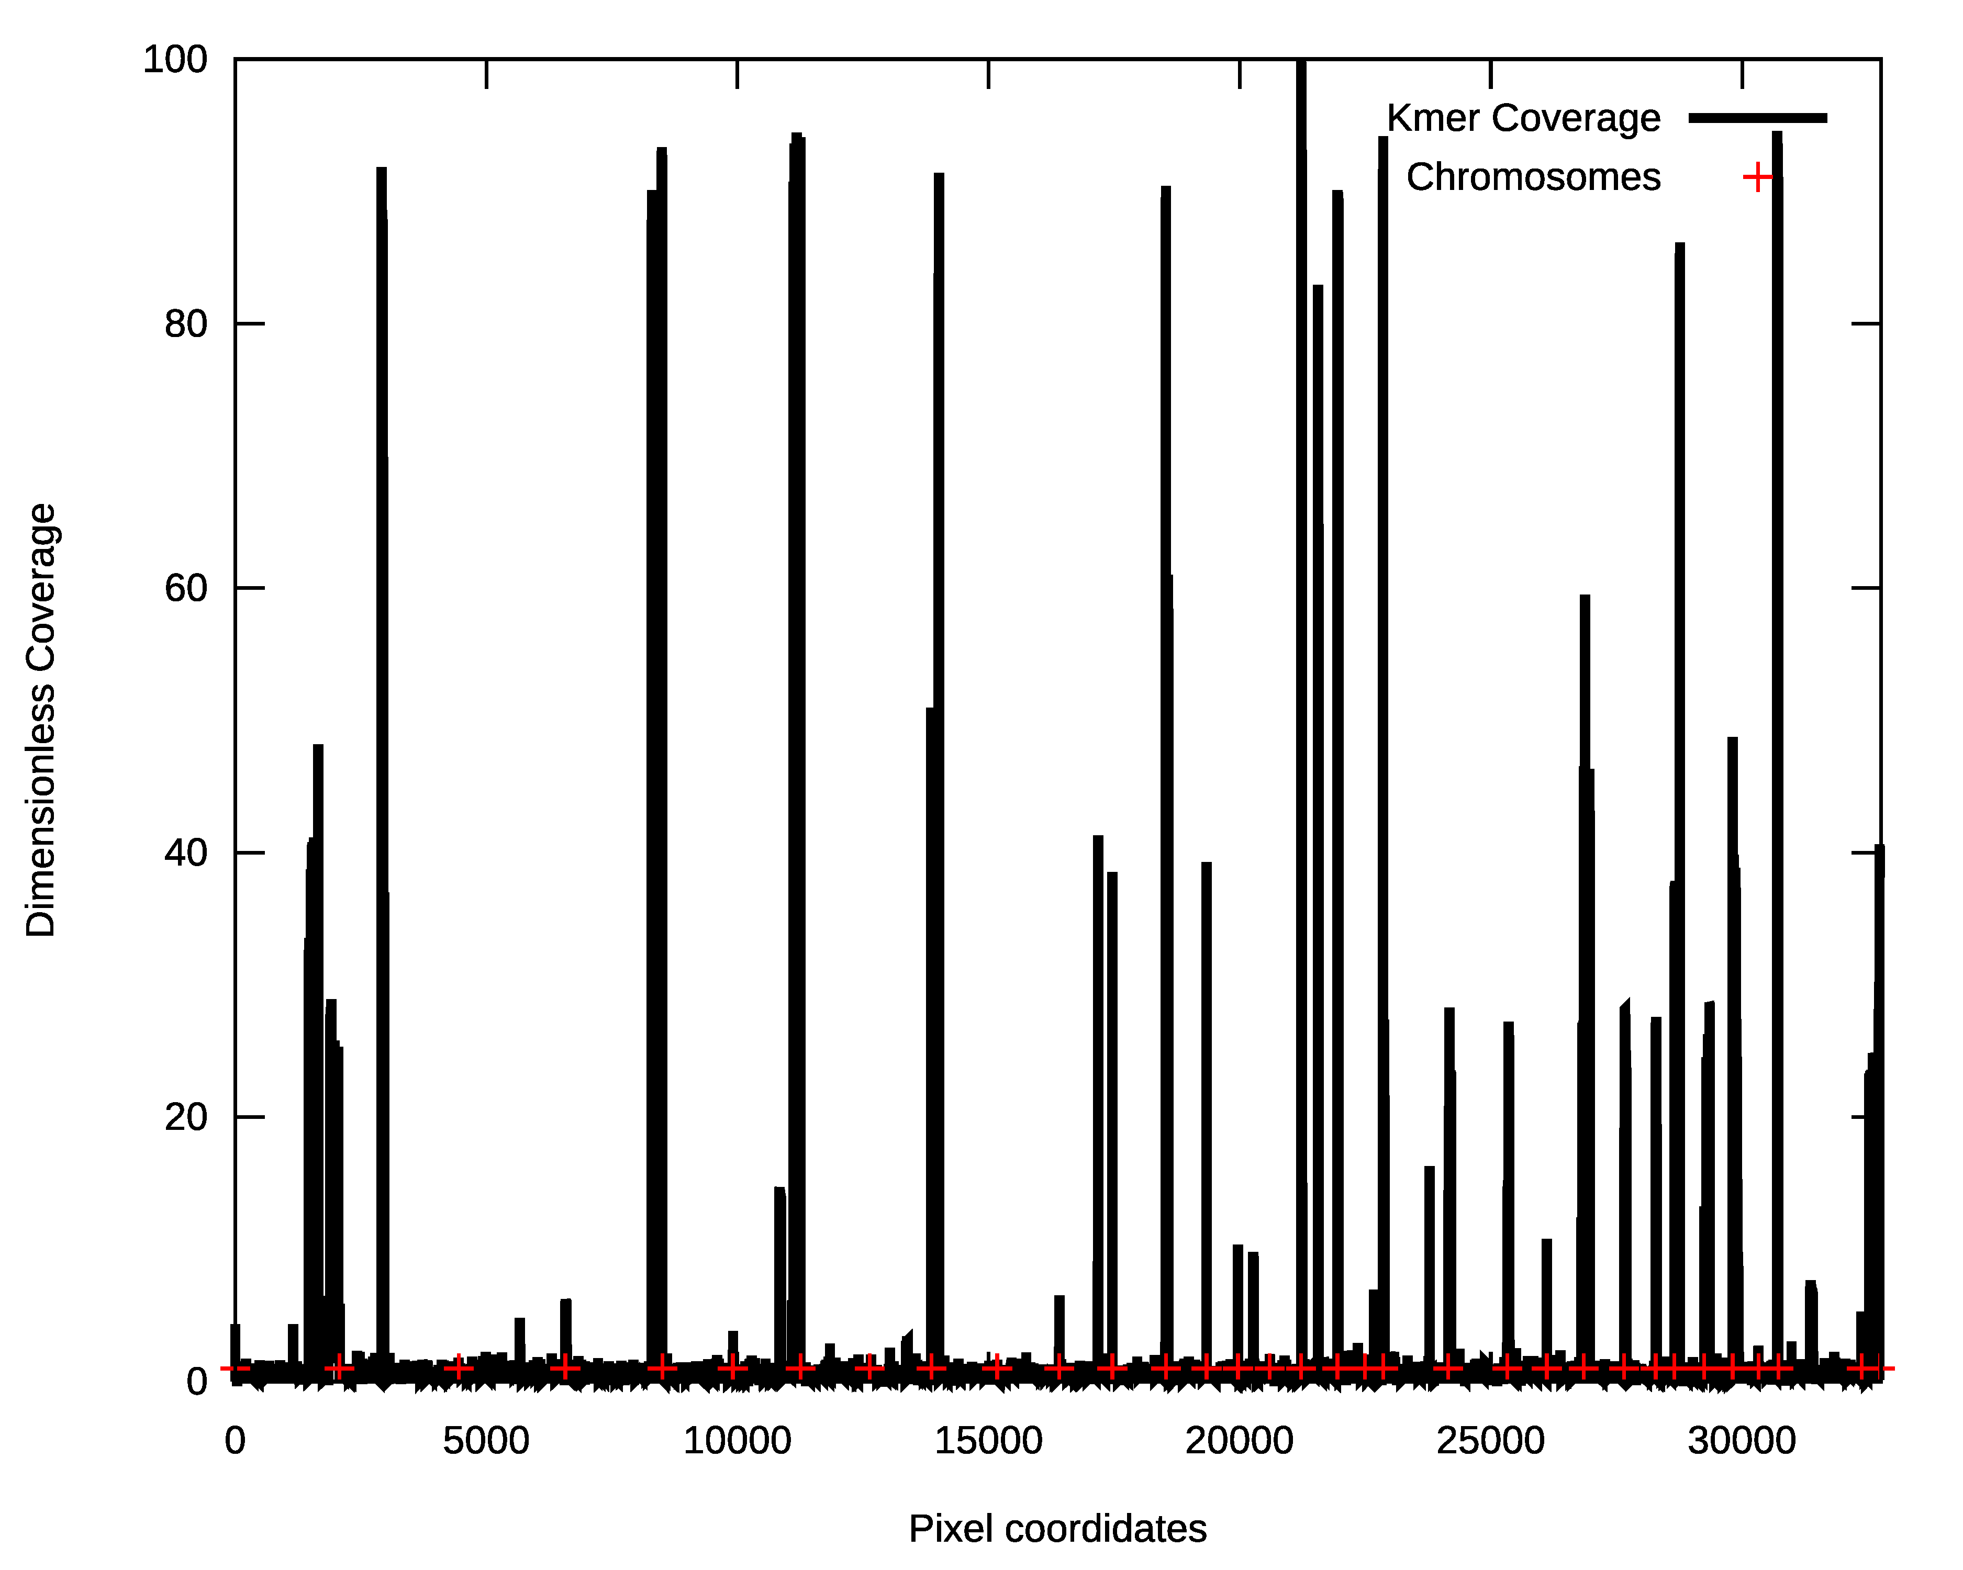
Centromere Locations – Donkey Genome

Slide 14
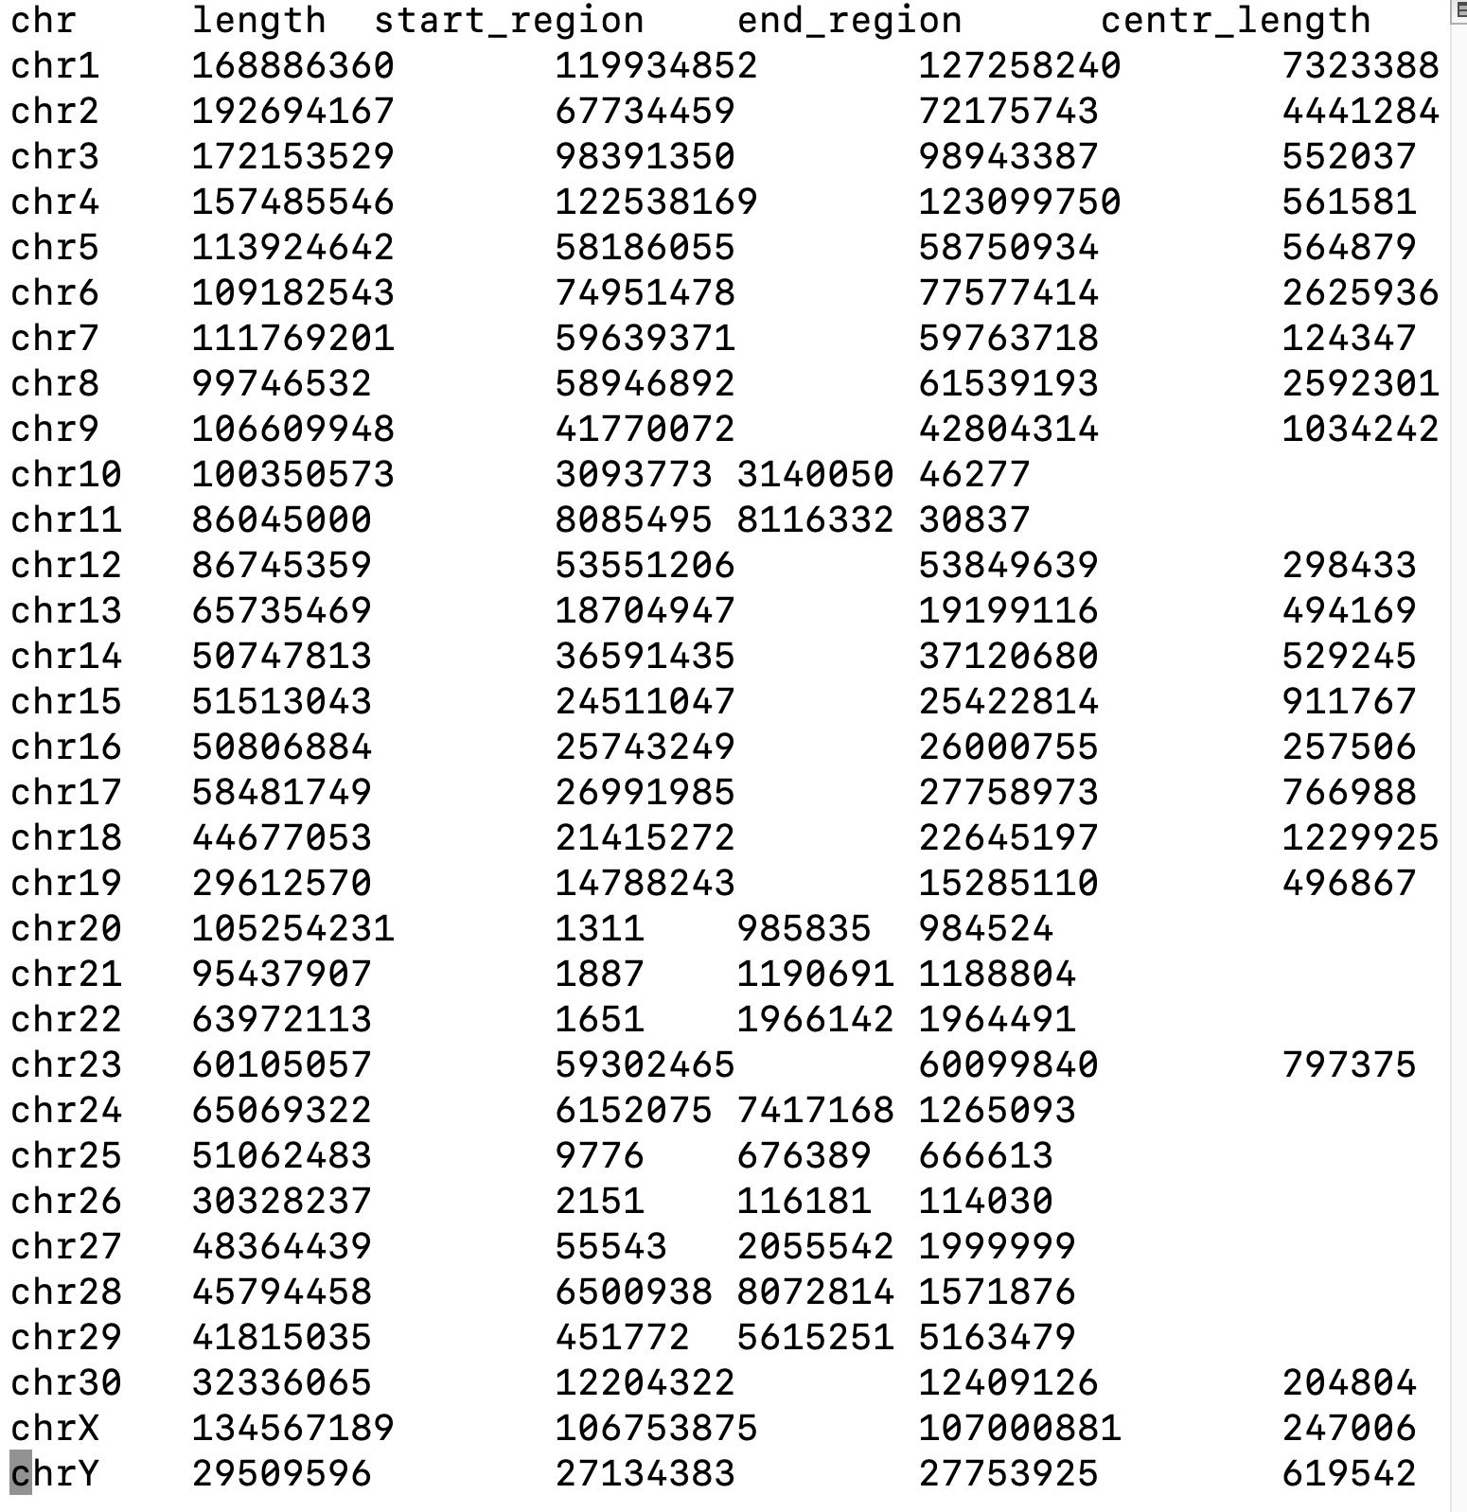
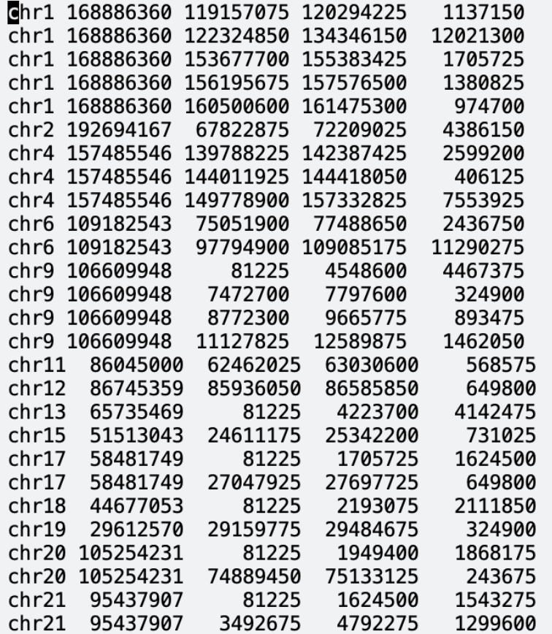
Donkey Genome Centromeres - I

Slide 15
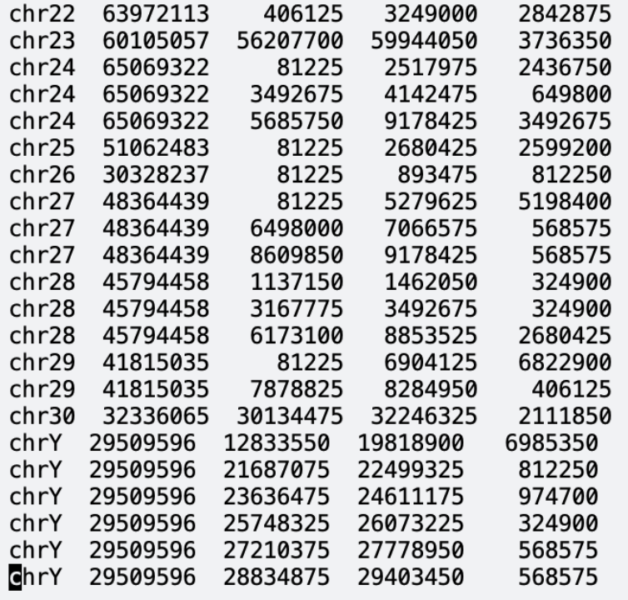
Donkey Genome Centromeres- II

Slide 16
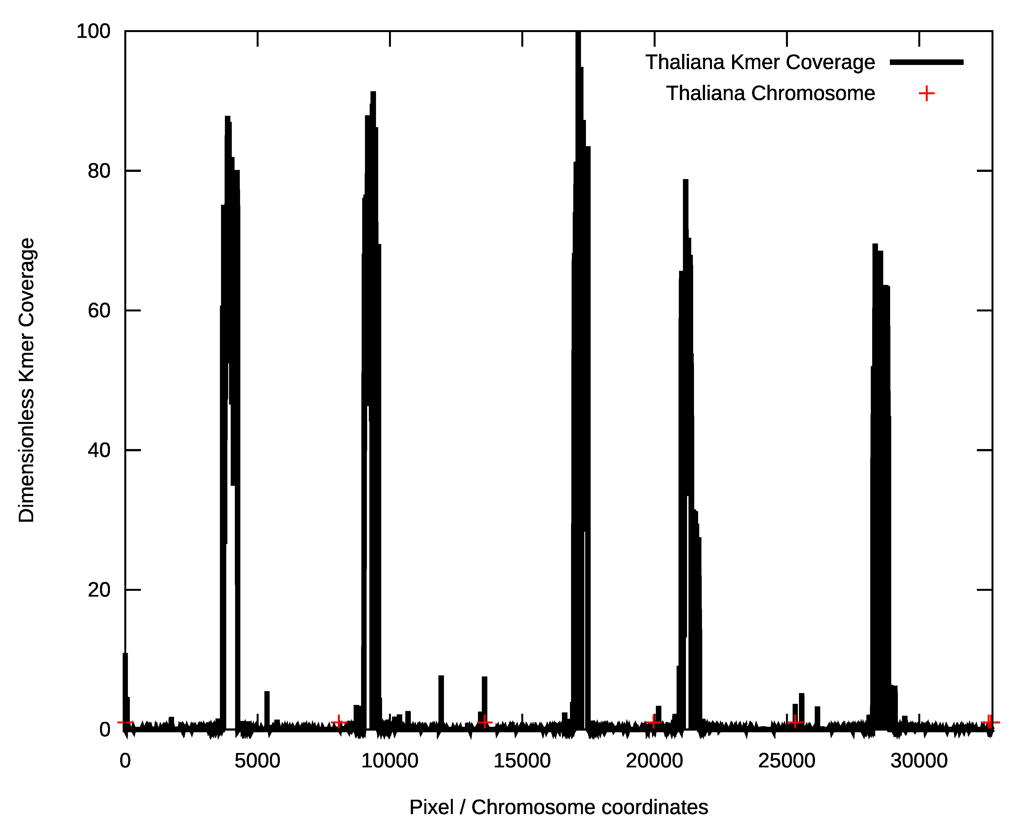
Centromere Locations – Arabidopsis Genome

Slide 17
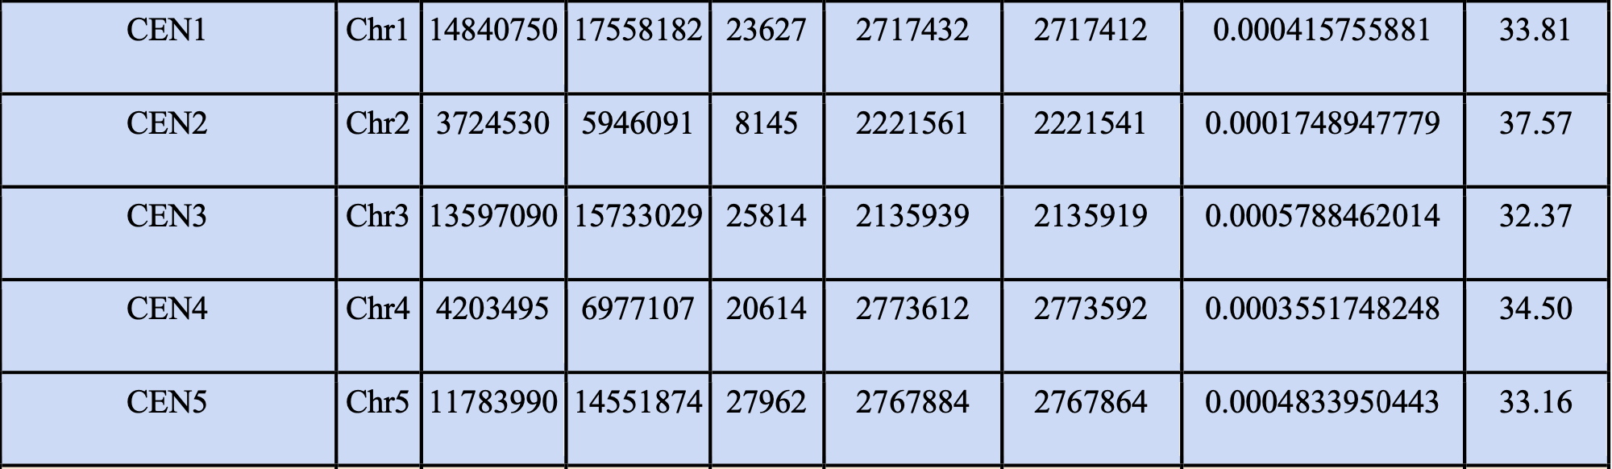
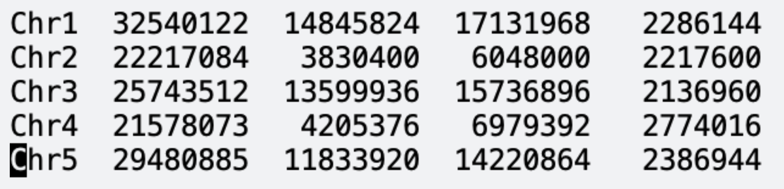
Centromere Locations – Arabidopsis Genome

Slide 18
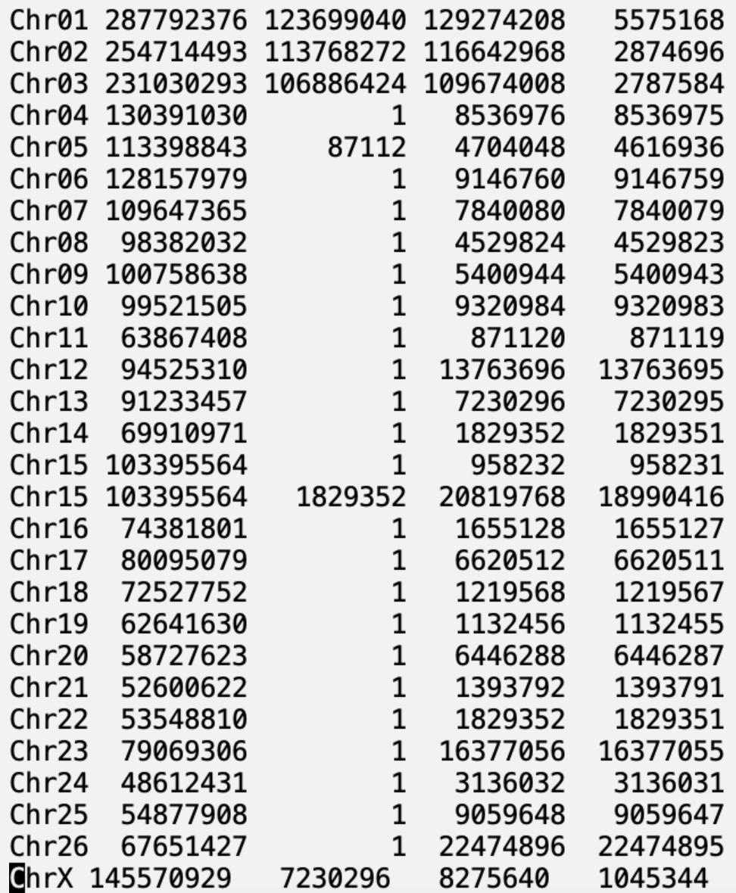
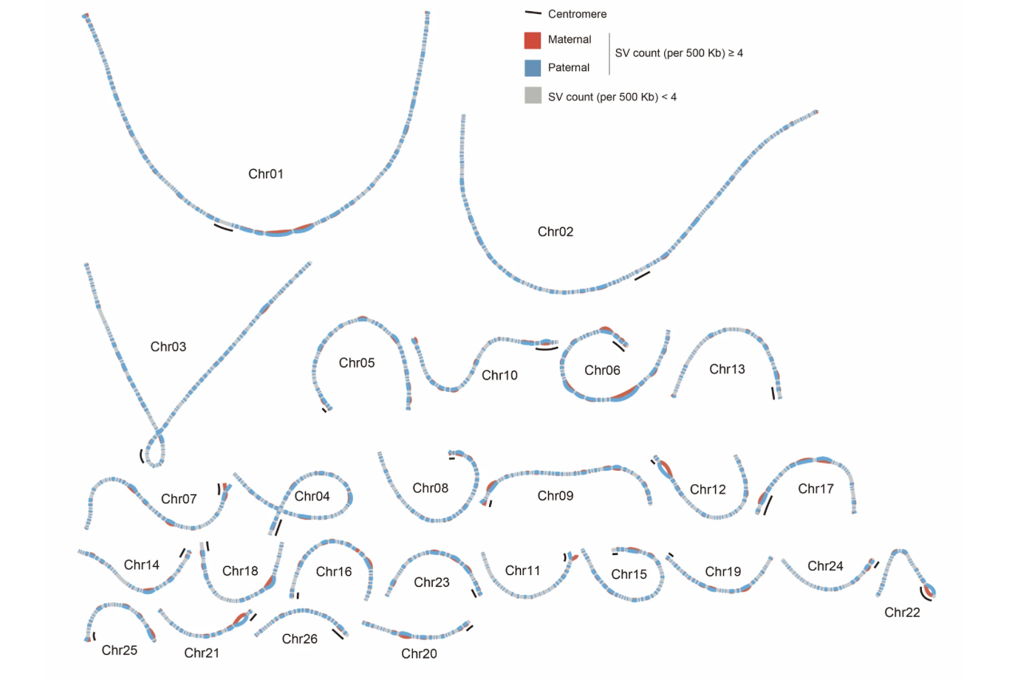
Sheep Centromeres

Slide 19
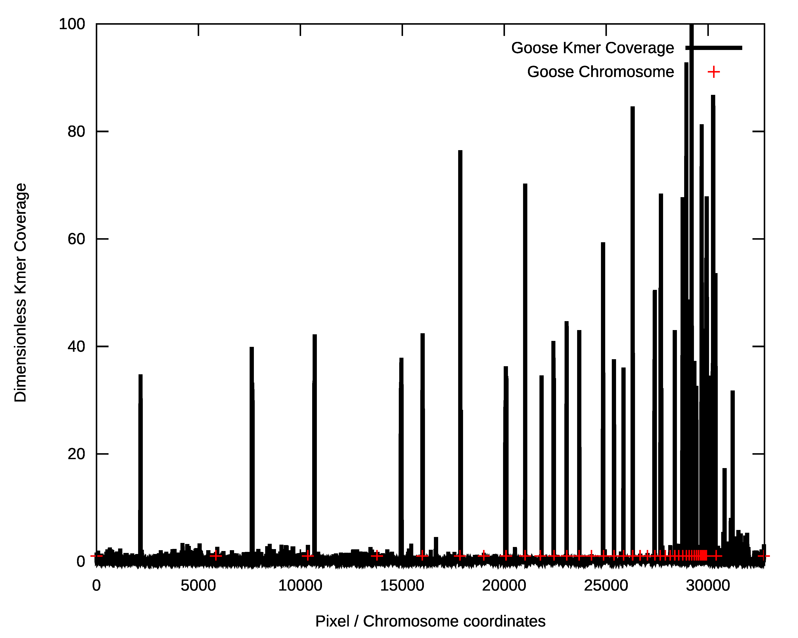
Goose Repeat Density on Pixels

Slide 20
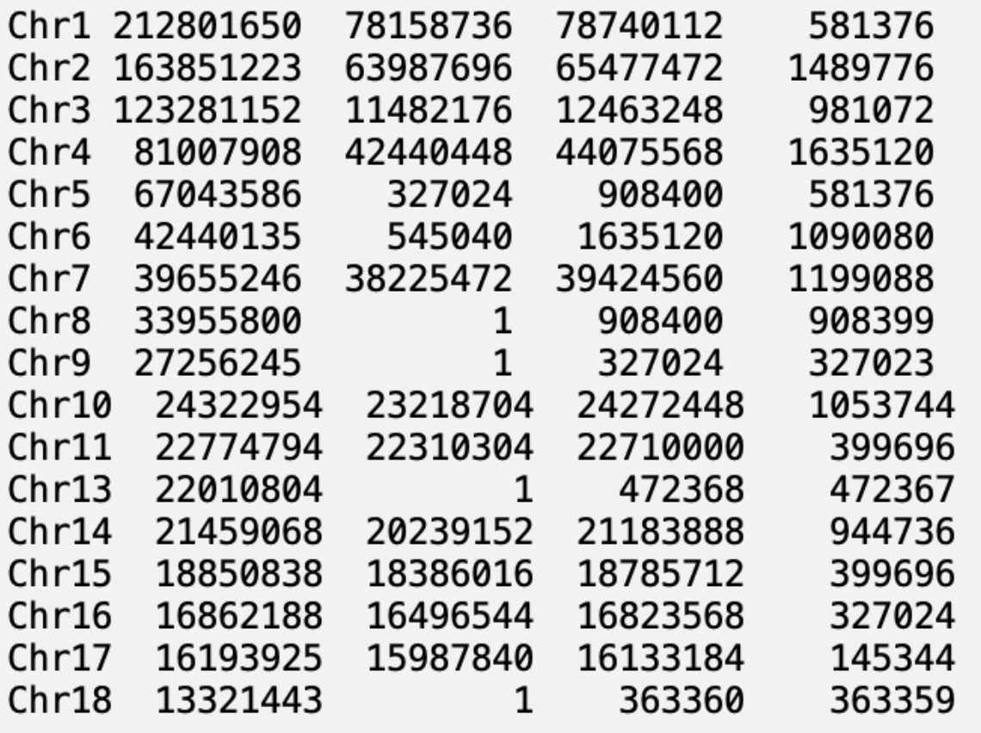
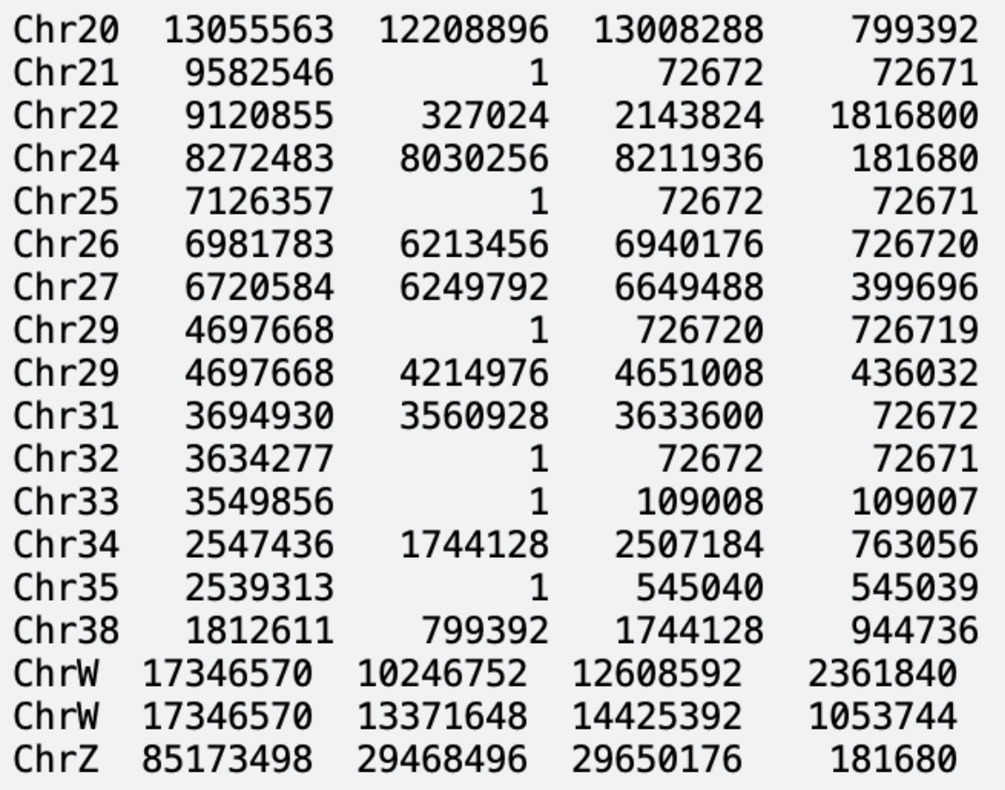
Centromere Locations – Goose Genome

Slide 21
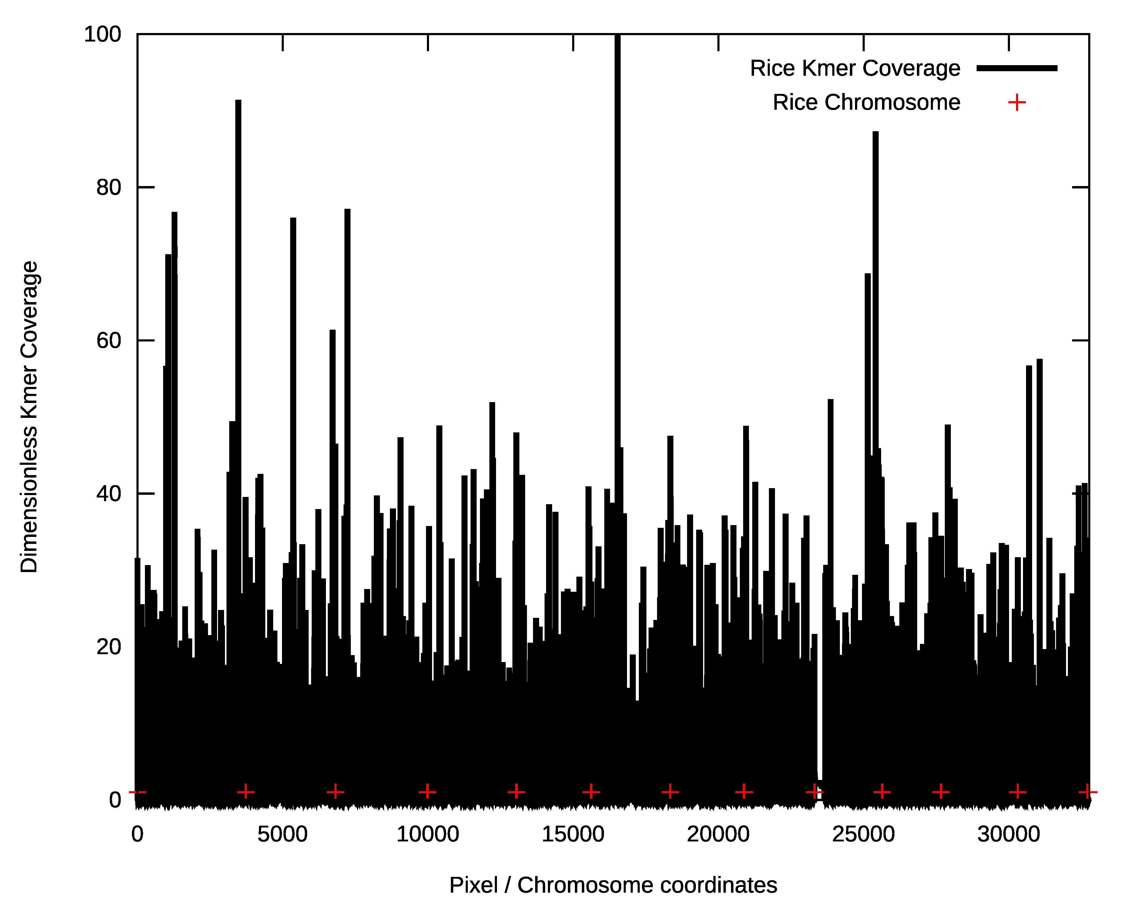
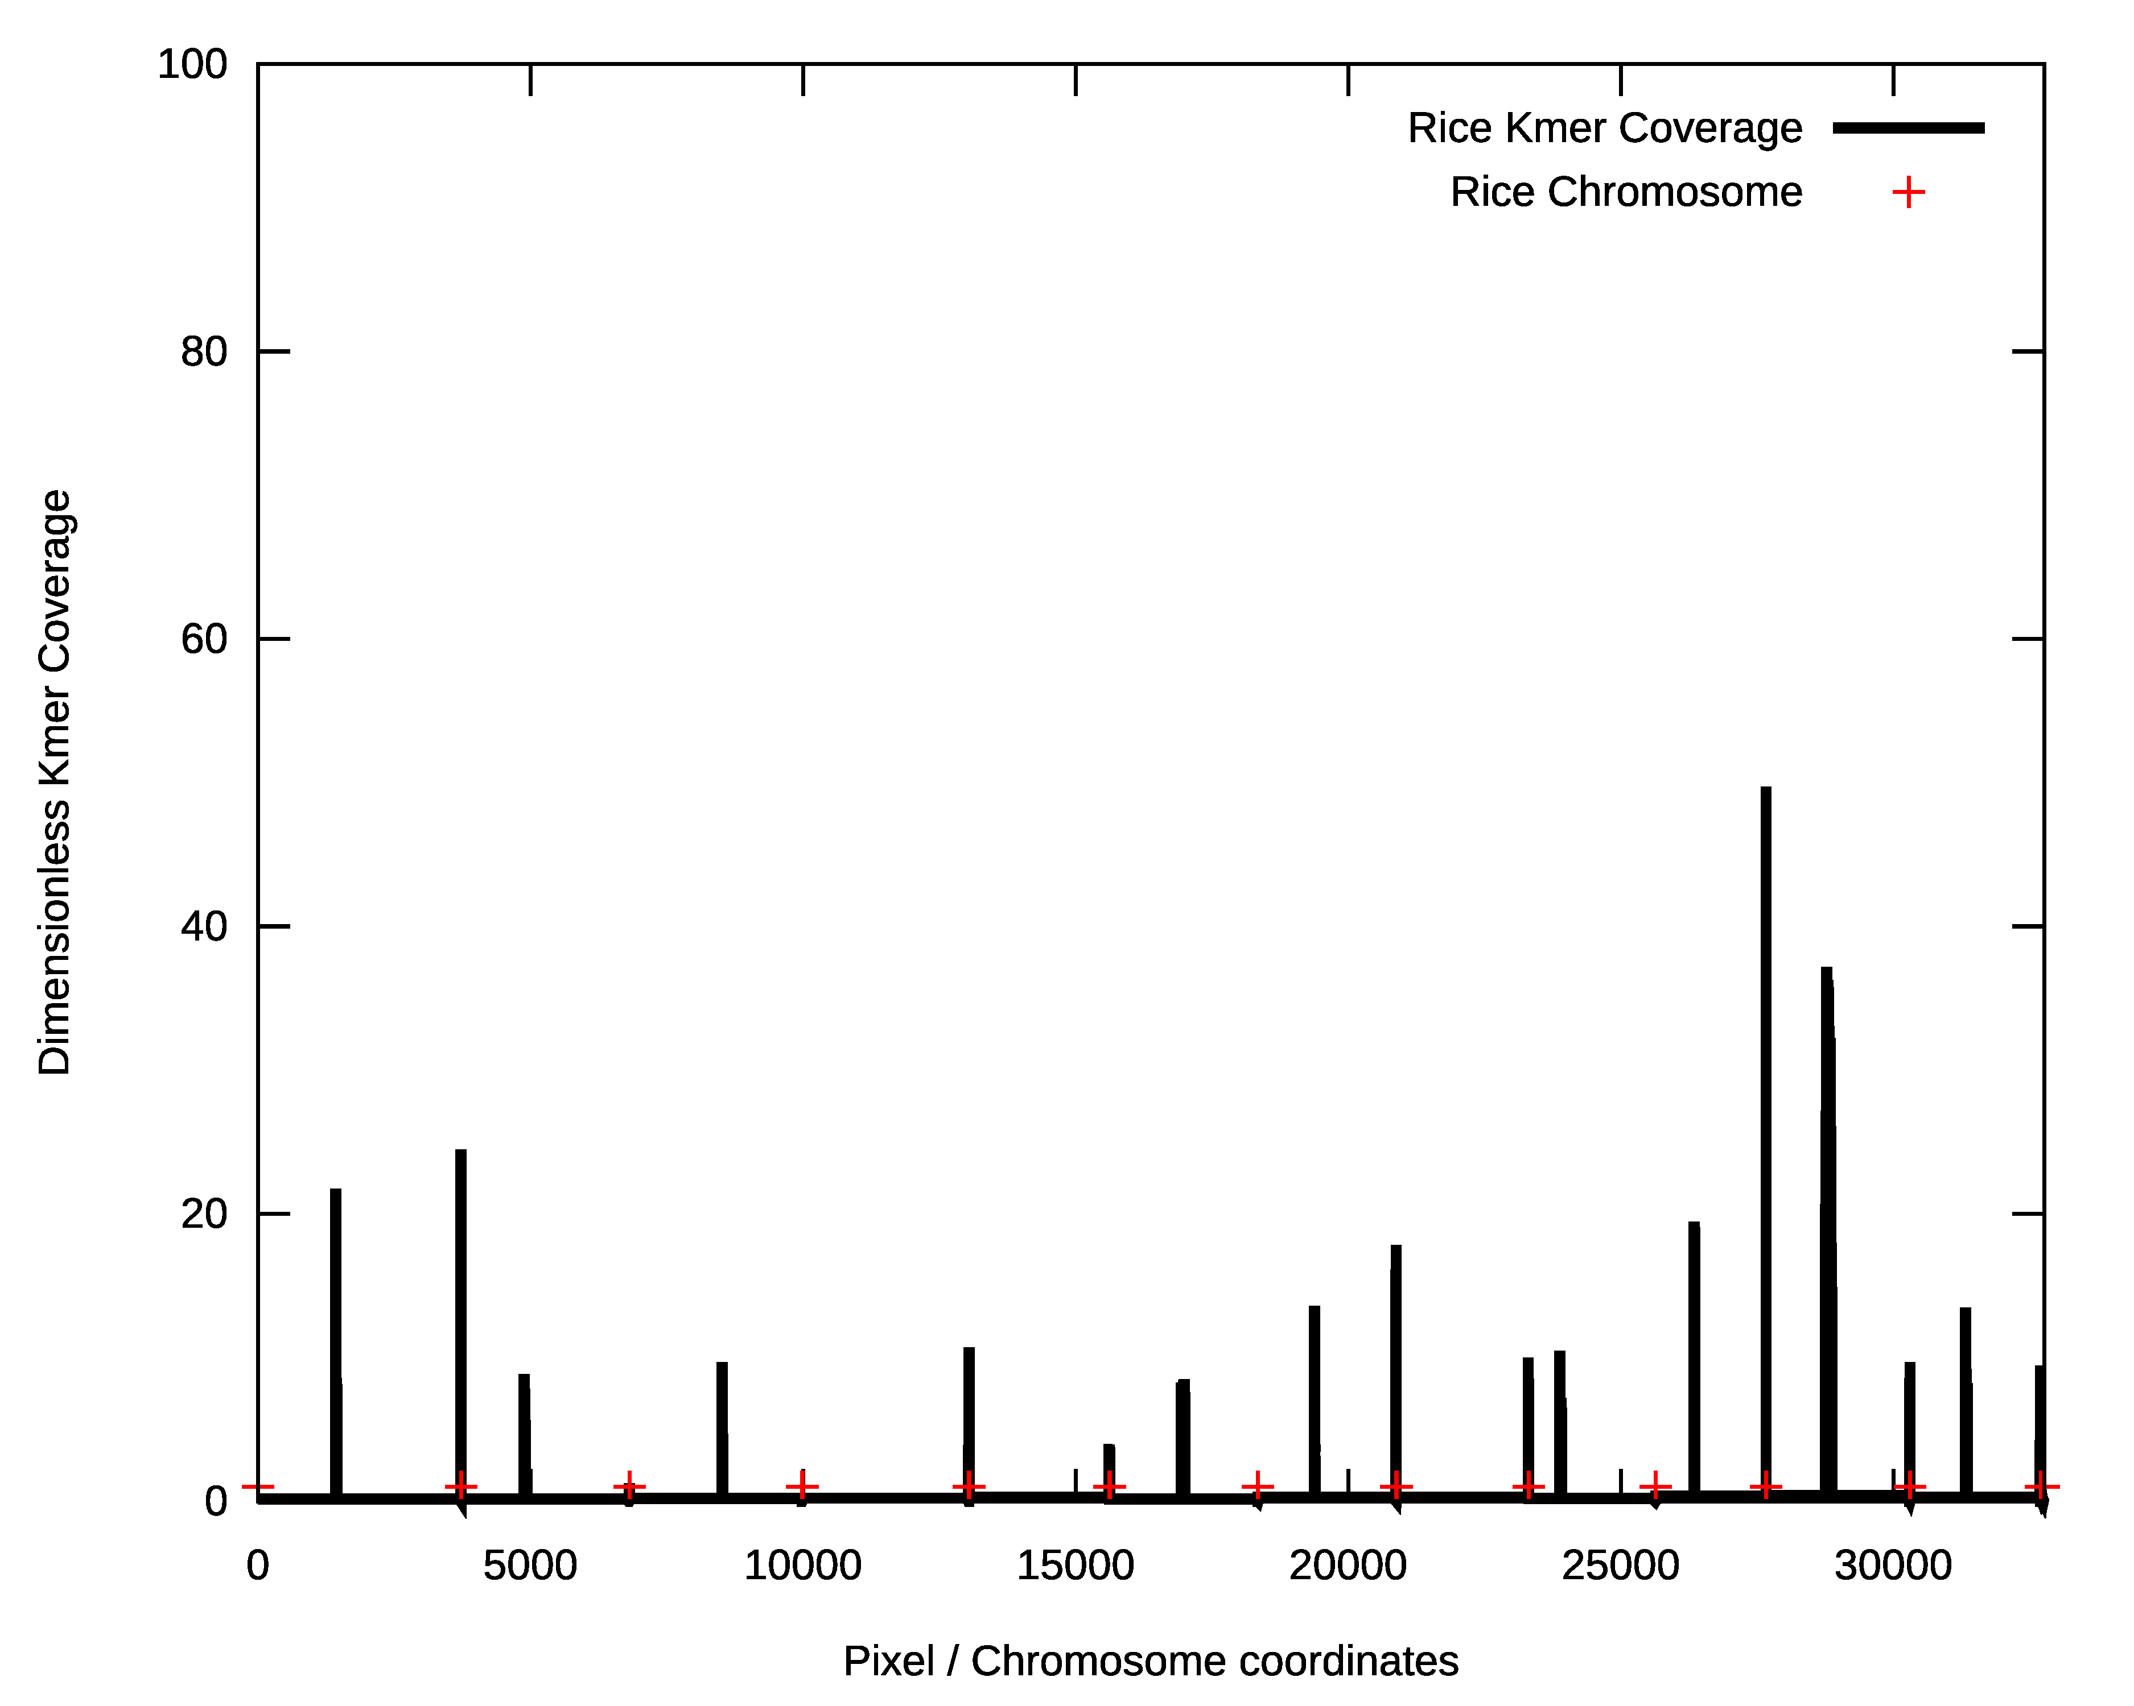
Rice Repeat Density on Pixels
Without denoise
With denoise

Slide 22
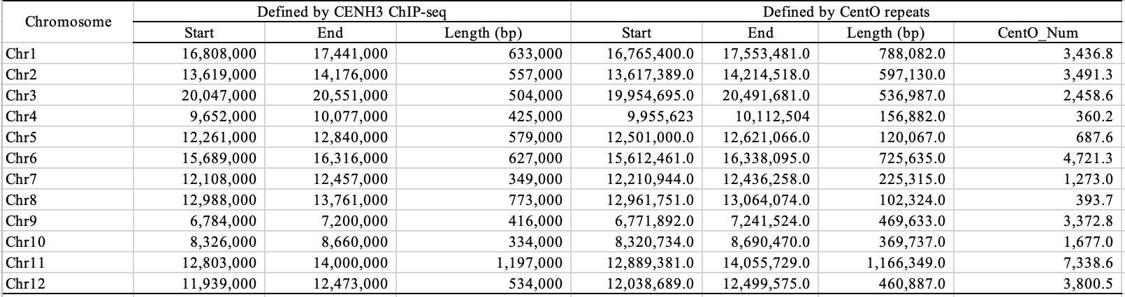
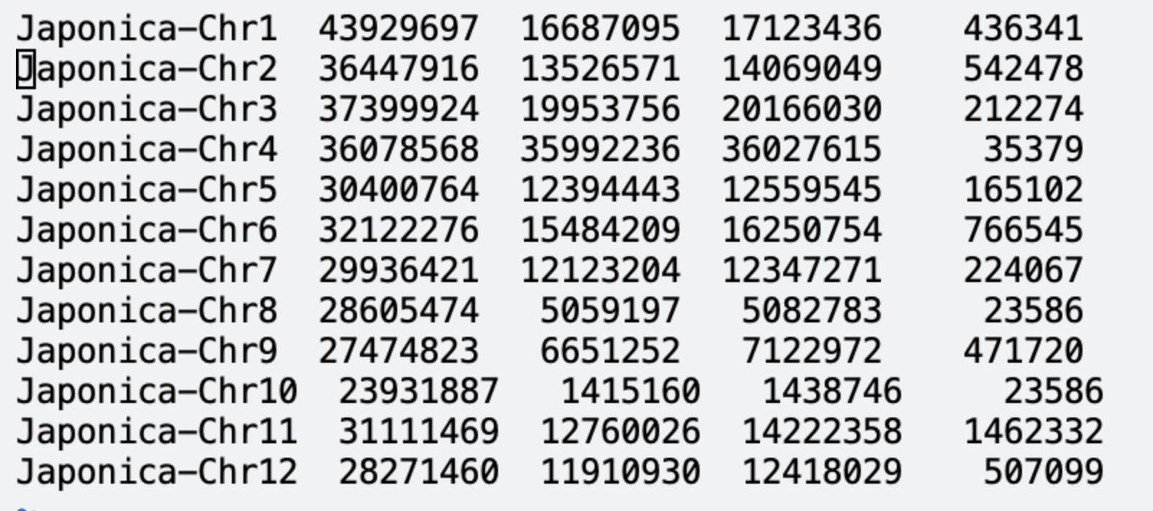
Centromere Locations – Rice Genome

Slide 23
https://github.com/wtsi-hpag/Kmeres
$ git clone https://github.com/wtsi-hpag/Kmeres.git
$ cd Kmeres
$ make
$ /nfs/users/nfs_z/zn1/src/kmeres/kmeres hash -kmer 31 -sample Human CHM13v2.fa meres.fa > cover.out \
Parameters:
kmer: Size of kmer word [ default = 31 ]
sample: Sample name
CHM13v2.fa: Input genome assembly file
meres.fa: Output centromere sequence file

